Slide 1

Java technology is a language of programming as well as a platform

Slide 2
Introduction: 1.popular programing language. 2.Class based general purpose and high level ,object oriented programing language 3.It support primitive data types and non primitive data types. primitive data types (int ,long ,float,double,char,byte,short,Boolean), non primitive data types(String,Arrays,interface,classes and object) 5.Helps to write a code once and run it any platform.so it called platform independent 6.Both compiled and interpreted language 7.JVM interprets(loader) the bytecode and converts it to platform specific machine code .hence it is called platform independent.

Slide 3
Uses: 1.Mobile , Desktop, Web appilications. 2.Games 3.Database connections 4.Robotics 5.Smartcard 6.Embedded system 7.Banking Appilications

Slide 4
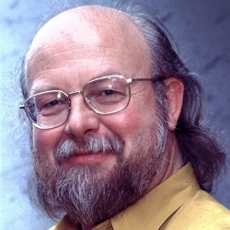
History of java
→in1991 JAMES GOSLING and his team started java project.
→initially it was designed for interactive television.
→till 1995 it was called “Oak”
→they discovered this name already existed.
→team gathered to choose a new name.
→team suggested various name like “dynamic”,”revoluntionary”,”silk”,”DNA”,and etc……
→james asked to choose a new name .
→team went out for coffee and the name java was born.
→JAMES and his team developed java at sun microsystem.
→JDK 1.0 released in jan 23 1996.

Slide 5
Java terminology
1.JDK:
→Java development kit
→This kits provides functionality required to develop, compile and excute your java appilication or program.
→The java development kit can be download from Oracle website.we need to install JDK on our computes,in order to create , compile and run the java program.
2.JRE:
→JDK includes JRE.
→JRE installation on our computer allows the java program to run ,however ,we cannot compile it.JRE includes a browser, JVM applet.supports and plugins.
→for running the java program, a computer needs JRE.

Slide 6
JVM [inside Ram]
→three execution phase of a program, they are written, compile and run the program.
Java programmer done by writing a program:
the compilation is done by javac compile.
Java compiler include in java development kit(JDK)
It takes Java program as input and generates bytecode as output.
JVM excecute the bytecode produce by the compiler
Every os has different jvm but the output the produces after the execution of byte code in the same across all the OS .so the java is known as platform independent language.
Bytecode development process:
JAVAC compiler of JDK compiles the java source code into bytecode. It can be executed by JVM ,it is saved by .classfile by the compiler.

Slide 7
How it work:
Public class ClassName{
main method}
Byte code
110010
110001
compiler
Demo.java
{ source code
Javac compiler
.classfile
Final output
Loader
(or)
interpreter
Byte code verify
excecution
JVM

Slide 8
Where classfile is keep ➔ Run ➔ workspace ➔ bin ➔ visible in .classfile:
JVM +library set
Development tool
+
JDK

Slide 9
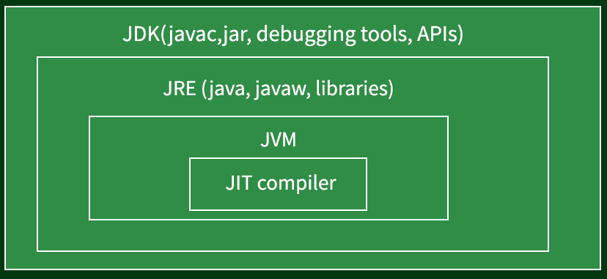
JIT:
Just In Time.
It improves the performance of JVM.

Slide 10
Java features:
Simple, easy and familiar:
Java is easy to learn and familiar because java syntax is just like c++.
It is simple because:
a) it does not use header files.
b) eliminated the use of pointer and operator overloading.
2. Platform Independent:
Write once, run anywhere (WORA)

Slide 11
3.Object-Oriented:
Java is Object oriented throughout language- that mean no coding outside of
class definitions, including main().
4. Robust:
Robust means inbuilt capabilities to handle errors/exceptions.
Java is robust because of following:
Built-in Exception handling.
Strong type checking i.e. all data must be declared an explicit type.
Local variables must be initialized.
Automatic garbage collection.
First checks the reliability of the code before Execution etc.

Slide 12
5. Secure: Java is secure because it provides:
1. access restrictions with the help of access modifiers (public, private etc).
2. byte codes verification – checks classes after loading.
Class loader – confines objects to unique namespaces.
Security manager – determines what resources a class can access such as reading and writing to the local disk.
6. Distributed:
Java provides the network facility. i.e. programs can be access remotely from any machine on the network rather than writing program on the local machine. HTTP and FTP protocols are developed in java.
7. Compiled and interpreted:
Java code is translated into byte code after compilation and the byte code is interpreted by JVM (Java Virtual Machine). This two steps process allows for extensive code checking and also increase security.

Slide 13
8. Portable:
Means able to be easily carried or moved. Write once, run anywhere (WORA) feature makes it portable.
9. Architecture-Neutral:
Java code is translated into byte code after compilation which is independent of any computer architecture, it needs only JVM (Java Virtual Machine) to execute.
10. High performance:
JVM can execute byte codes (highly optimized) very fast with the help of Just in time (JIT) compilation technique.
11. Re-usability of code:
Java provides the code reusability With the Help of Inheritance.

Slide 14
12. Multithreading:
Java provides multitasking facility with the help of lightweight processes called threads.
13. Dynamic:
Java have the capability of linking dynamic new classes, methods and objects.

Slide 15
Java Naming Convention
To make your code eaiser to read for yourself and other programmer.
Readability of Java program is very important
Java follows camel-case syntax for naming the class, interface, method, and variable.
If the name is combined with two words, the second word will start with uppercase letter always such as firstName, secondName

Slide 16
Class
It should start with the uppercase letter.
2. It should be a noun such as Color, Button, System, Thread, etc.
.
Eg:
Public Class Employee
Interface
It should start with the uppercase letter.
2. It should be an adjective such as Runnable, printable
Eg:
Interface EmployeeDetail Printable

Slide 17
Method
It should start with lowercase letter.
2. It should be a verb such as main(), print(), println().
3. If the name contains multiple words, start it with a lowercase letter followed by an uppercase letter such as actionPerformed().
Eg:
Public Class Employee{
Public void getDetail(){
}
Public void detail(){
}}

Slide 18
Variable
It should start with a lowercase letter followed by an uppercase letter such as name , firstName.
2. It should not start with the special characters like & ,$ ,_ etc.
Eg:
Public Class Employee{
String firstName;}
Package
It should be a lowercase letter such as com.java.example.
2. If the name contains multiple words, it should be separated by dots (.)
Eg: com.employee.detail

Slide 19
Constant
It should be in uppercase letters such as RED
2. If the name contains multiple words, it should be separated by an underscore(_)
3. It may contain digits but not as the first letter.
Eg:
Final int MIN_AGE=12;
Final String NAME=“Shalini”;

